Slide 1
FCA Website
Description

Slide 2
Fonts- Nexa Bold(For all the titles & headings) & Regular and the WorkSans Family (For the body copy).
FCA is written in a particular format.
FIND is in Nexa Bold font
Creative Avenues LLP is in Nexa Regular font
Please follow the xd file share by Joshua.

Slide 3

Home page-
Section 1
The home page will consists of 6 sections:
Section 1 will comprise of the copy- ‘We are FINDCreative Ave. to create is to unite/design first/we keep it simple’
Section 2, 3, 4 & 5 will comprise of our top 4 projects (which we will finalise & inform you)
Section 6 will be the hyperlinked area which will direct to our work page.
Section 2
Section 3
Section 4
Section 5
Section 6

Slide 4
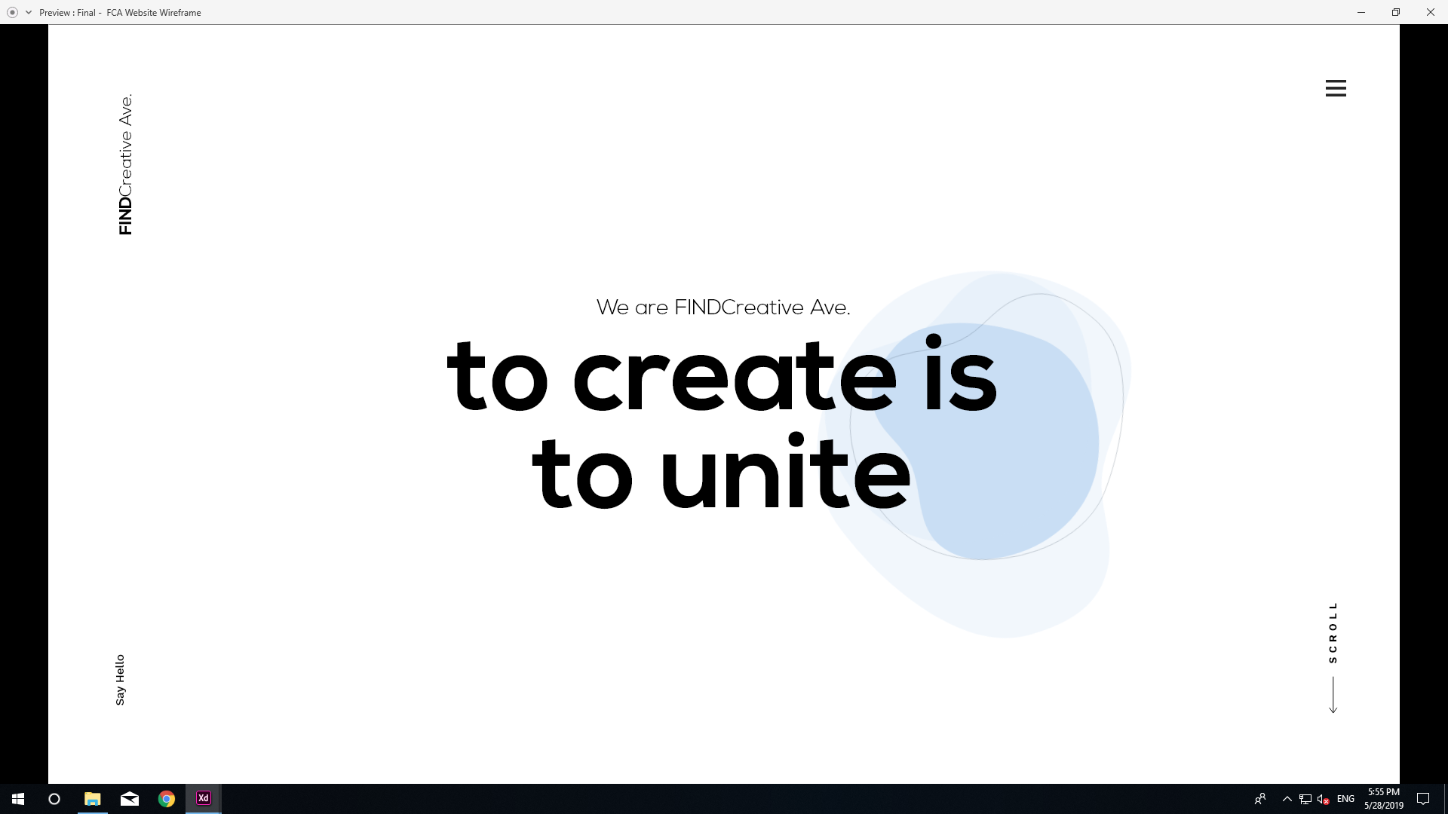
Home page- Section 1
This amoeba like formation will be constantly moving/changing shape, all the four layers will move separately in different shapes.
When this button will be clicked the menu page will scroll down from the top
“FINDCreative Ave.” will be visible on all the pages
And link to the home page every time when clicked upon
This button will direct to the Connect Page
This button will simply scroll the pages down
This copy will be constant changing (we will provide you with the copy)
Mandates- “FINDCreative Ave. & Menu Button will be scroll lock & will be visible on all pages.

Slide 5
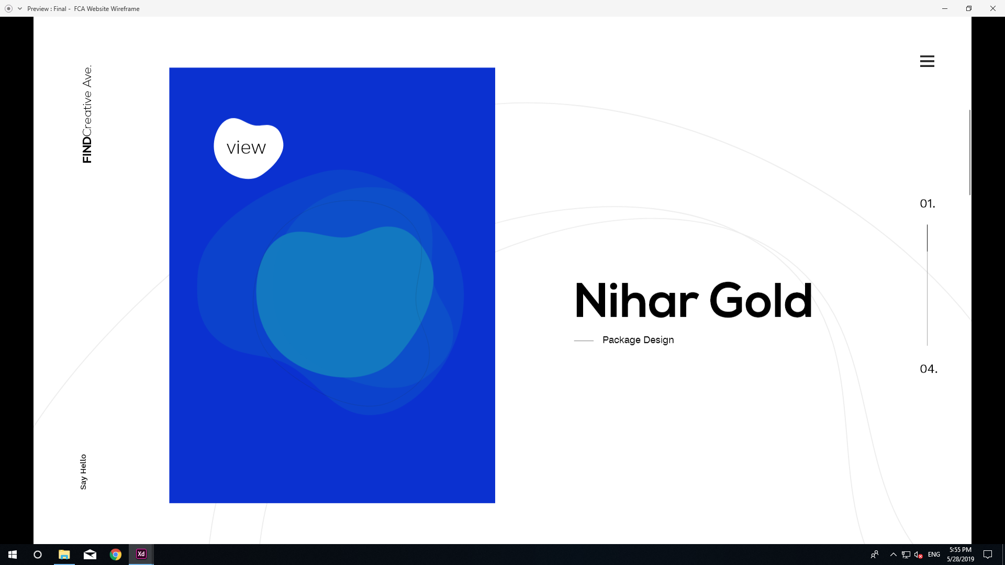
Home page- Section 2, 3, 4 & 5
These lines will keep dynamically moving
This amoeba like formation will be constantly moving/changing shape behind the image, all the four layers will move separately in different shapes.
This box will consists of the project images. The box colors will be different in all the sections
This will indicate the project sections on the home page, from 01. to 04. respectively.
Project Name & Work Category
Section 2, 3, 4 & 5 will be similar except of the projects.

Slide 6
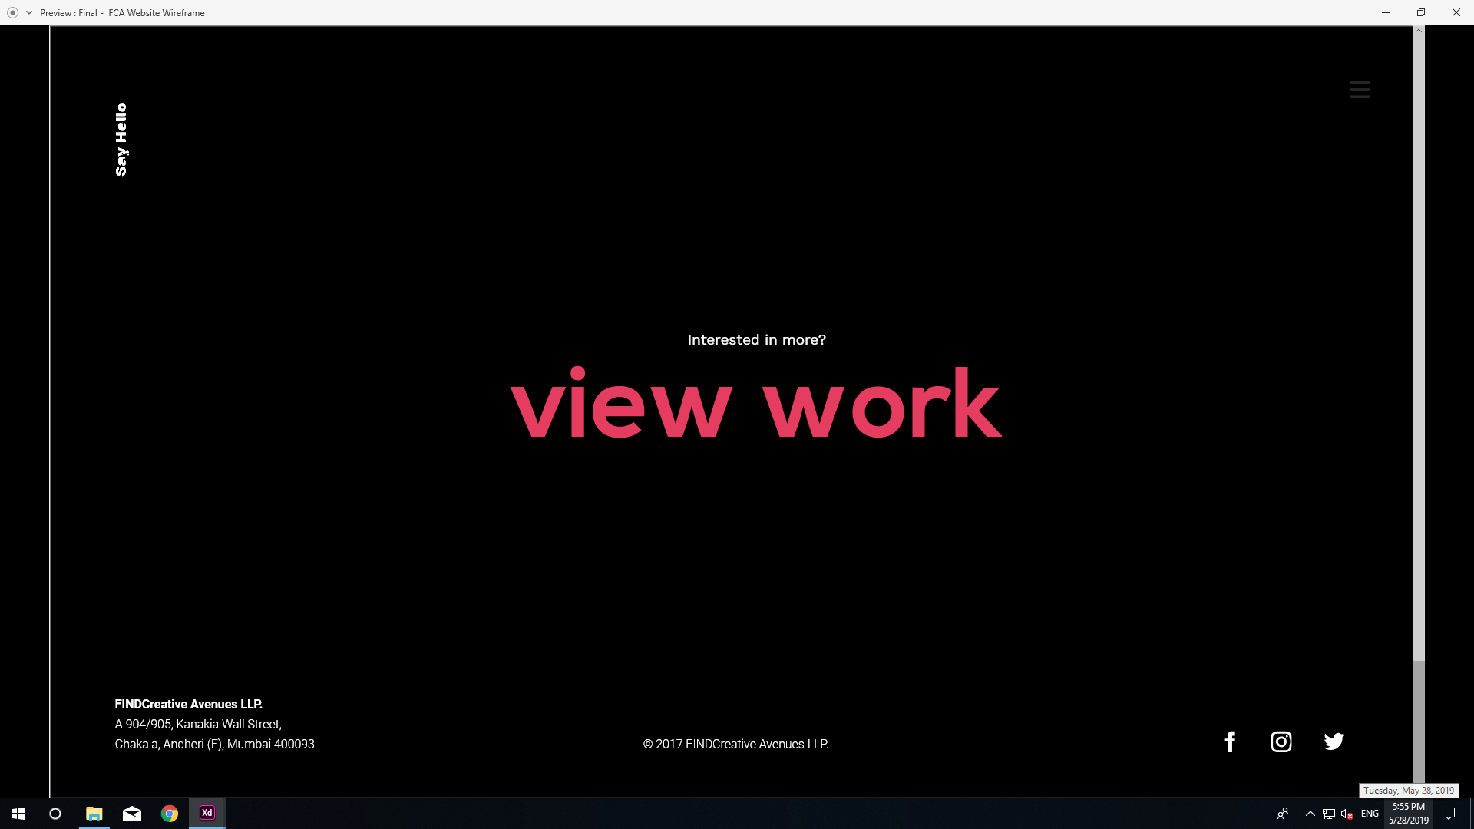
Home page- Section 6
Make the menu button white in color here
Say hello will move up in this page
View work will direct to the Work Page.
‘The address & @2017FINDCreative Avenues LLP’ will be present at the end of the last sections in all pages
These icons will direct to their respective social media platforms

Slide 7
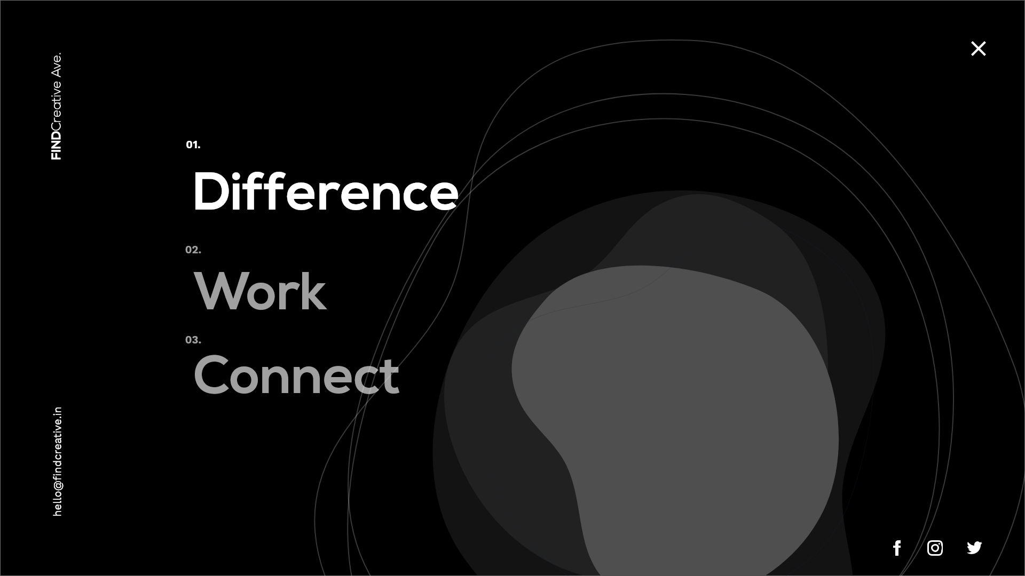
Menu page
These titles will link directly to their respective pages.
The font color will be grey for this and when clicked upon the color will change to white.
This ‘email-id’ will allow the users to mail us directly hence this will link to the mailing browser. This will be locked on the menu page
This amoeba like formation will be constantly moving/changing shape, all the four layers will move separately in different shapes.
These icons will direct to their respective social media platforms
These lines will keep dynamically moving

Slide 8
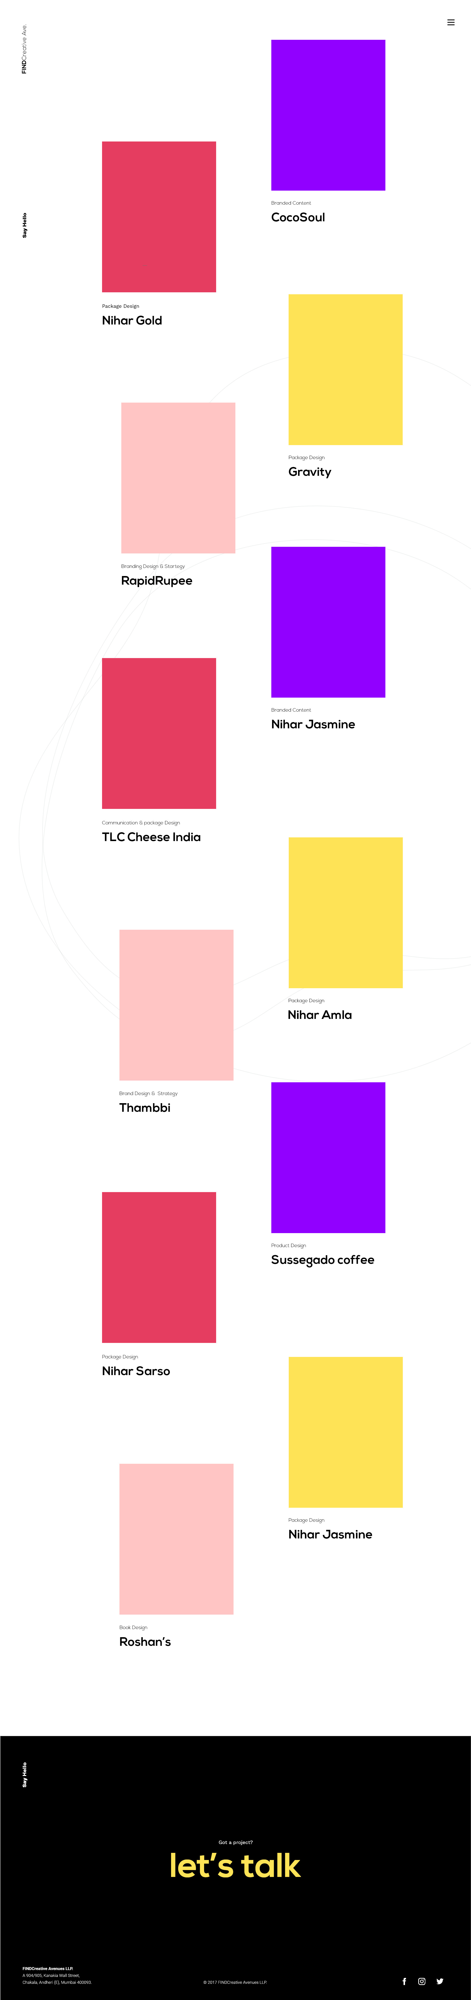
Work page-
The Work Page is divided into 2 sections:
Project Display (12-14 projects which will make 7-8 sections)
Let’s talk (last section)
Project Display
Let’s talk

Slide 9
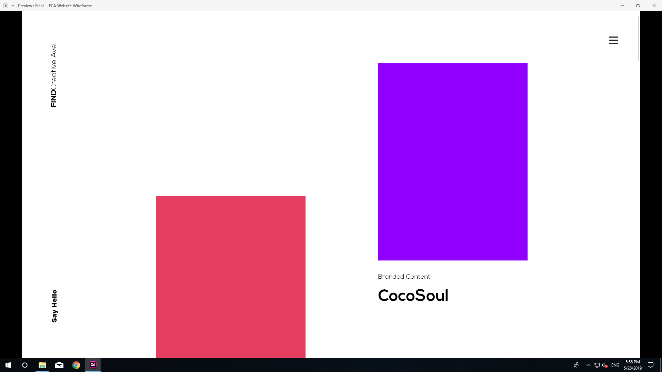
Work page- Project Display
This box will consists of the project images. The box colors will be different in all the sections
Project Name & Work Category

Slide 10
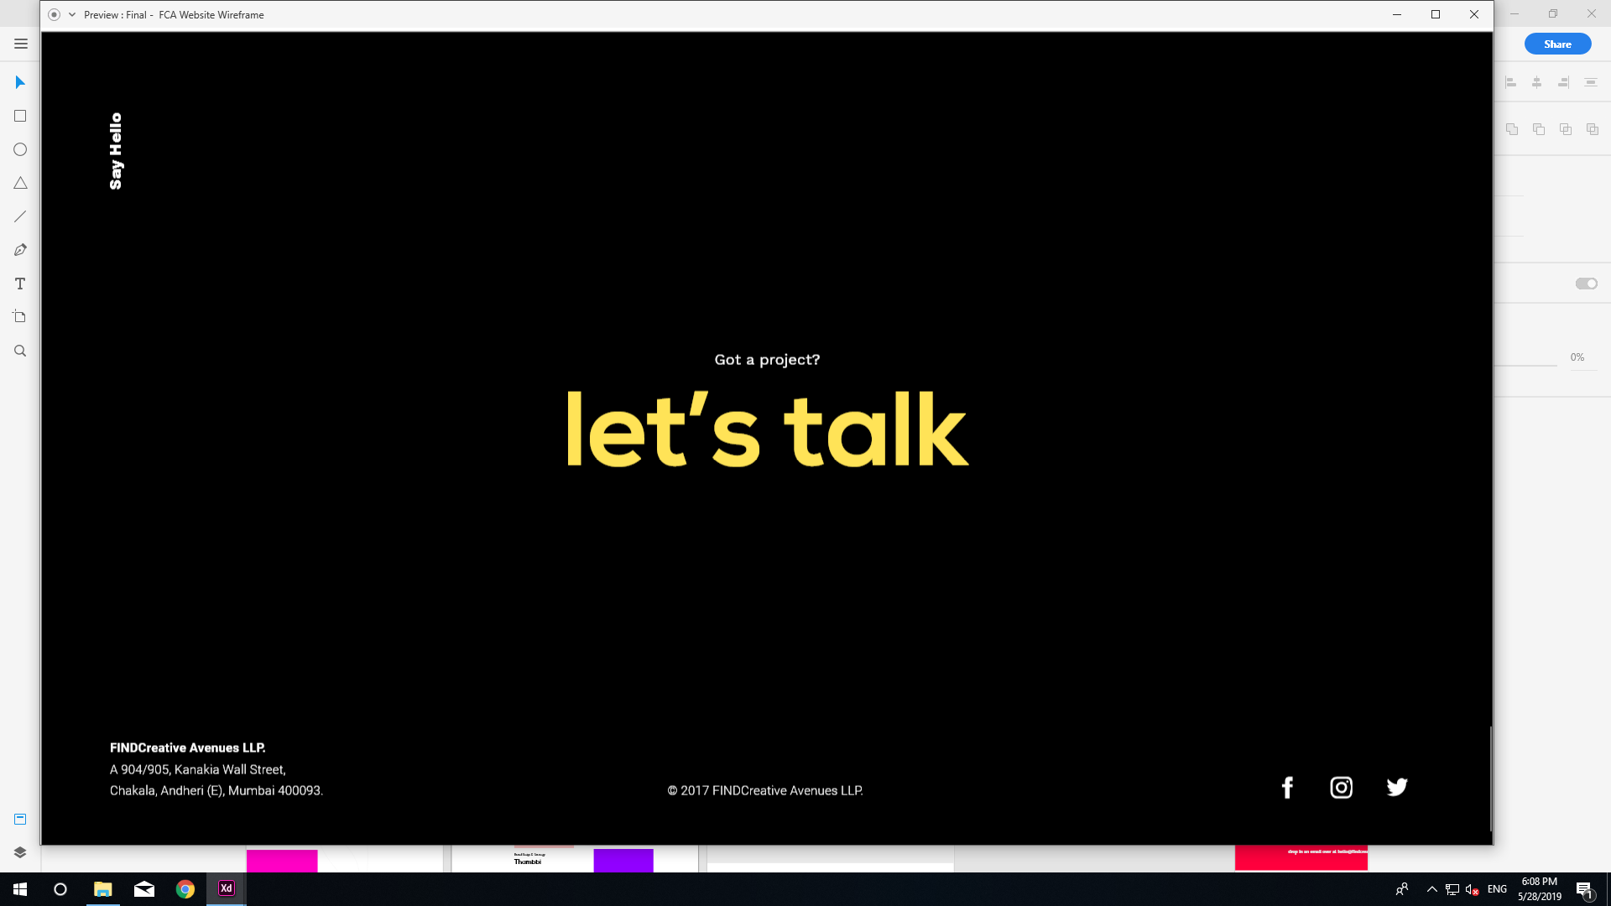
Work page- Project Display
Clicking on ‘let’s talk’ will direct to the Connect page

Slide 11
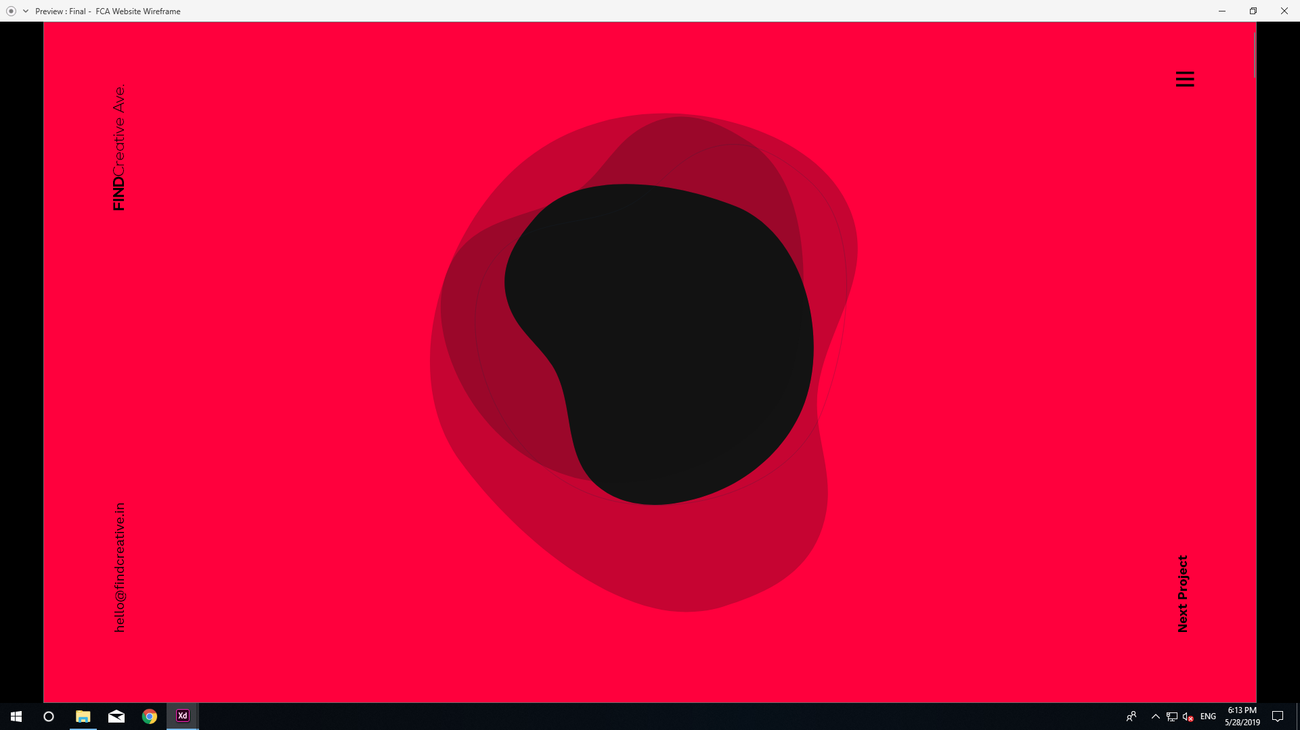
Project Page 1
This amoeba like formation will be constantly moving/changing shape, all the four layers will move separately in different shapes.
There will be a project image place at the center of this section
This will link to the next project

Slide 12
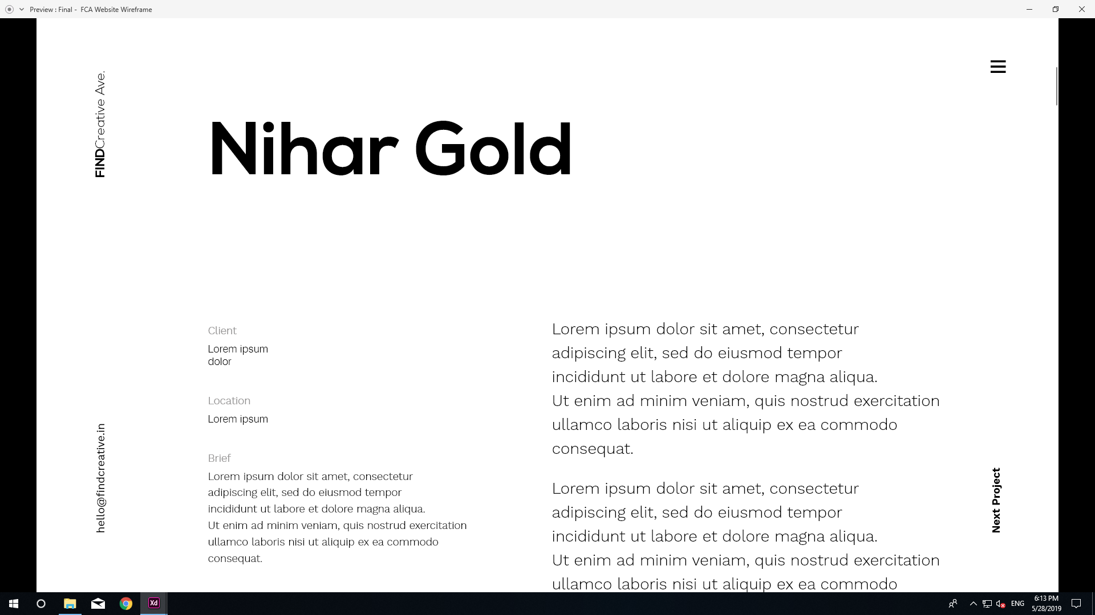
Project Page 2
The brand’s name will be in Nexa Bold font .
This ‘email-id’ will allow the users to mail us directly hence this will link to the mailing browser. This will be locked on the menu page
The copy for each project will be provided by us
This will link to the next project

Slide 13
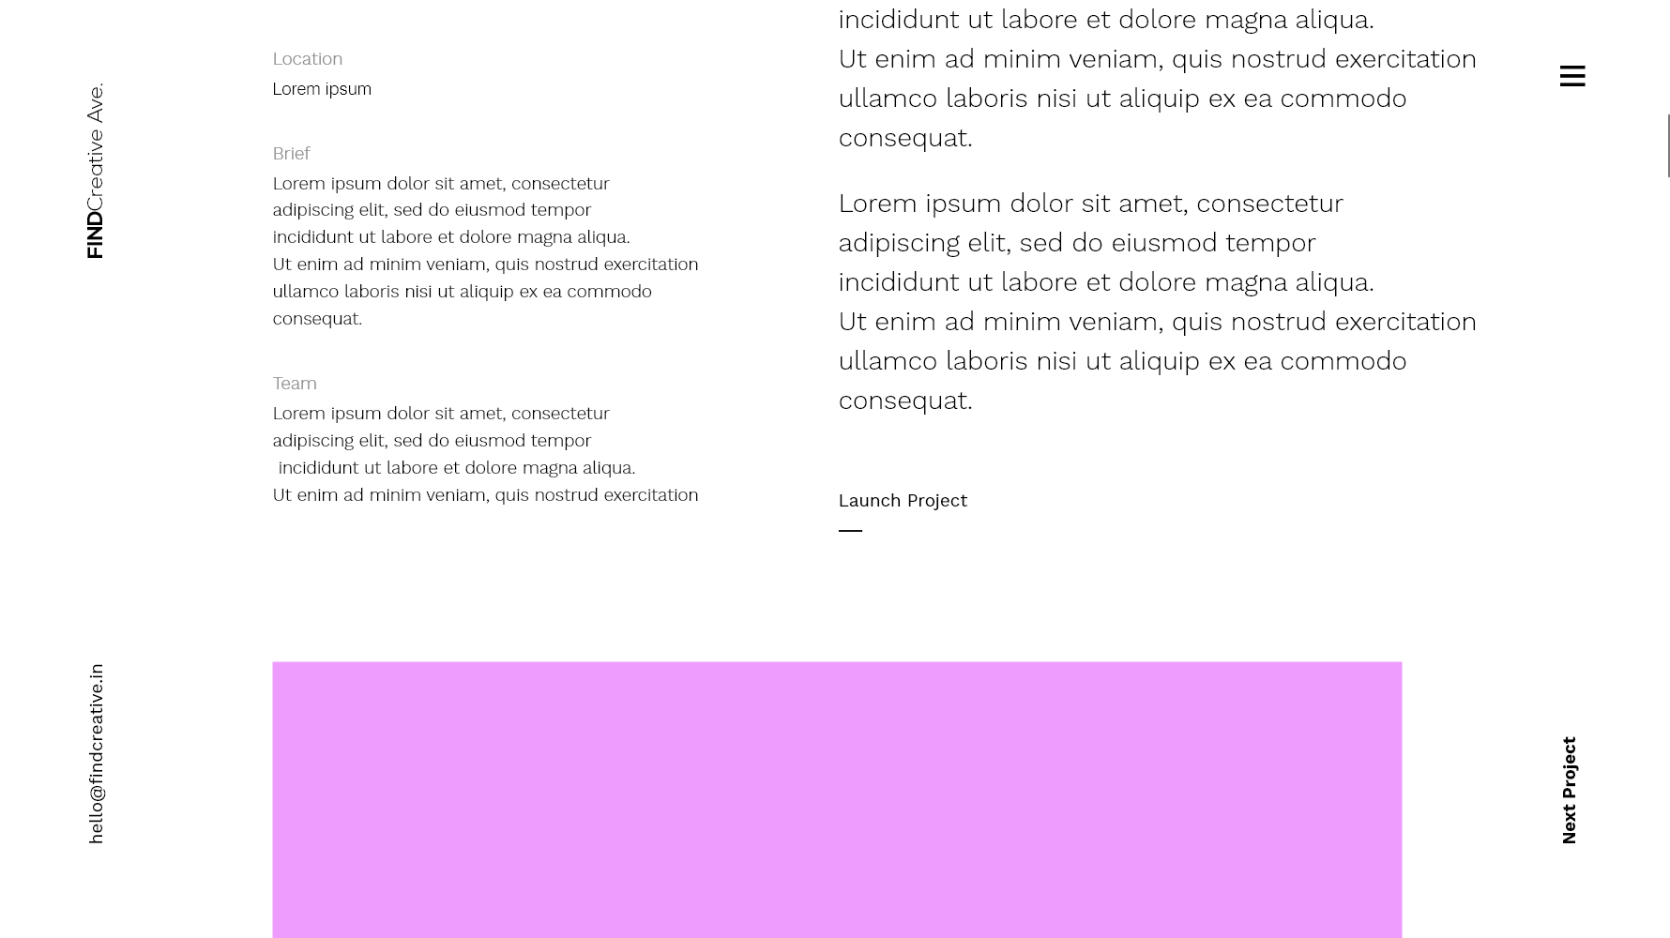
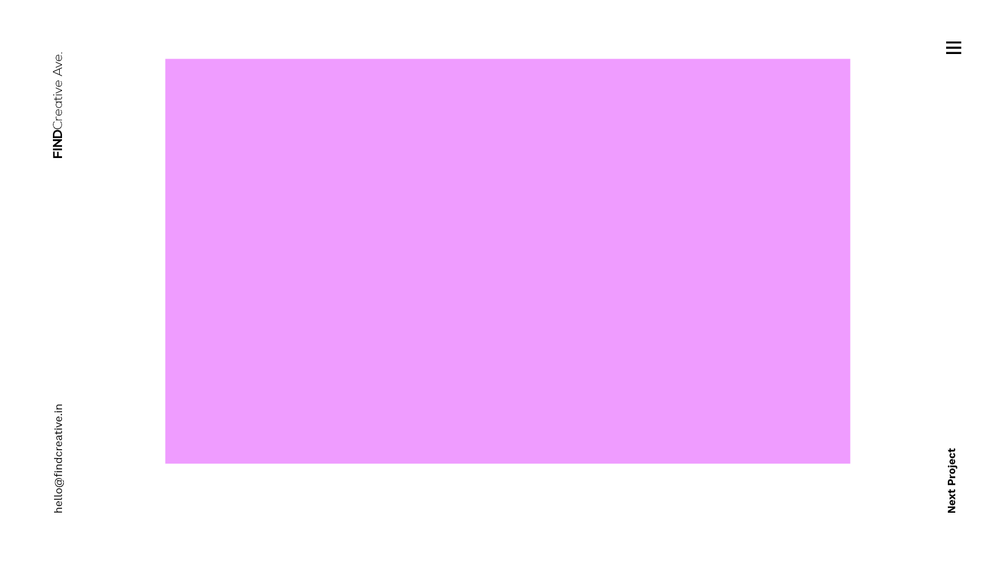
Continued section 2
An image will be followed by the copy and if required more copy can be added below the image

Slide 14
Project page- last section
Clicking on ‘let’s talk’ will direct to the Connect page

Slide 15
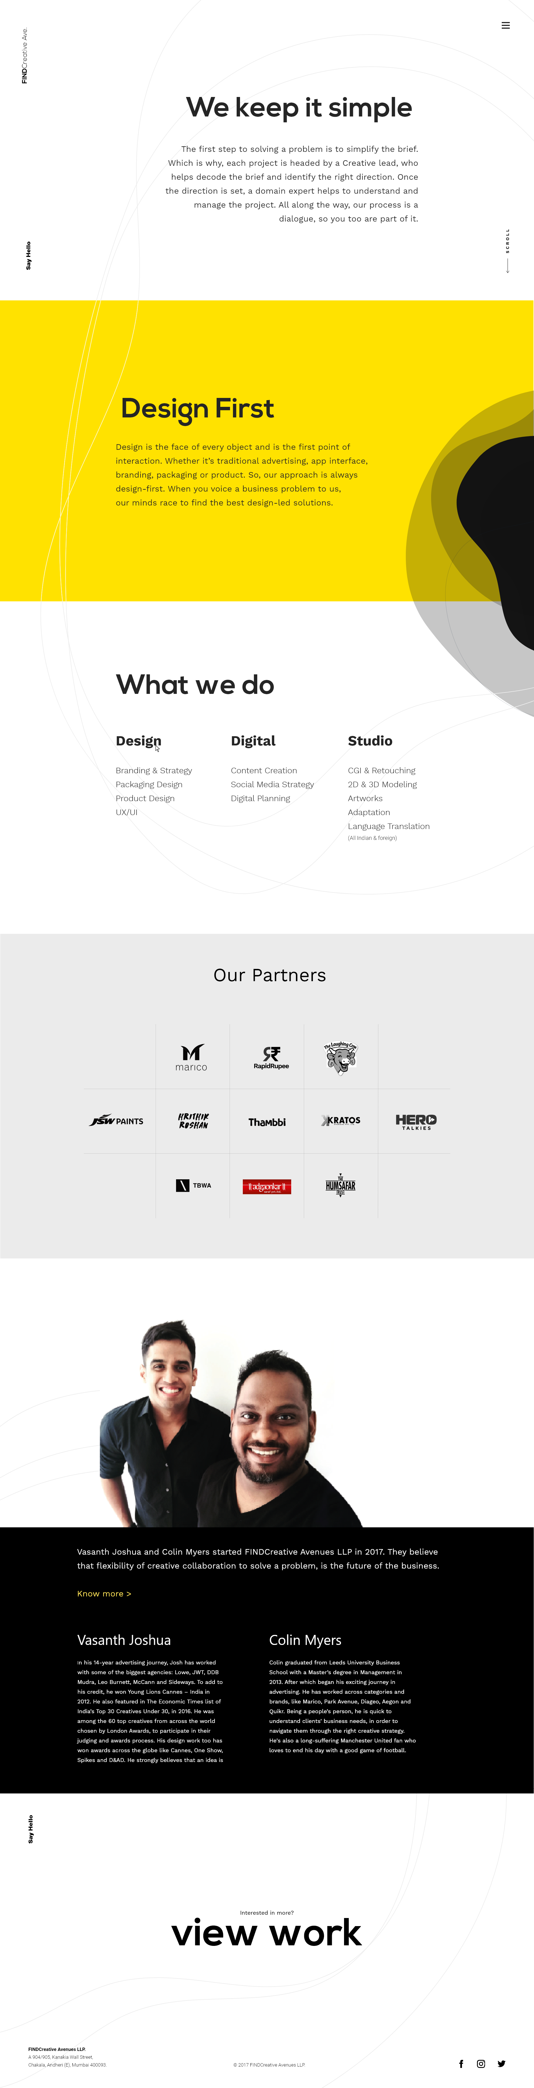
Difference Page
The Difference page will be an ‘about us page’. Divided into 6 sections:
We Keep it Simple
Design First
What we do
Our Partners
Founders
View Work

Slide 16
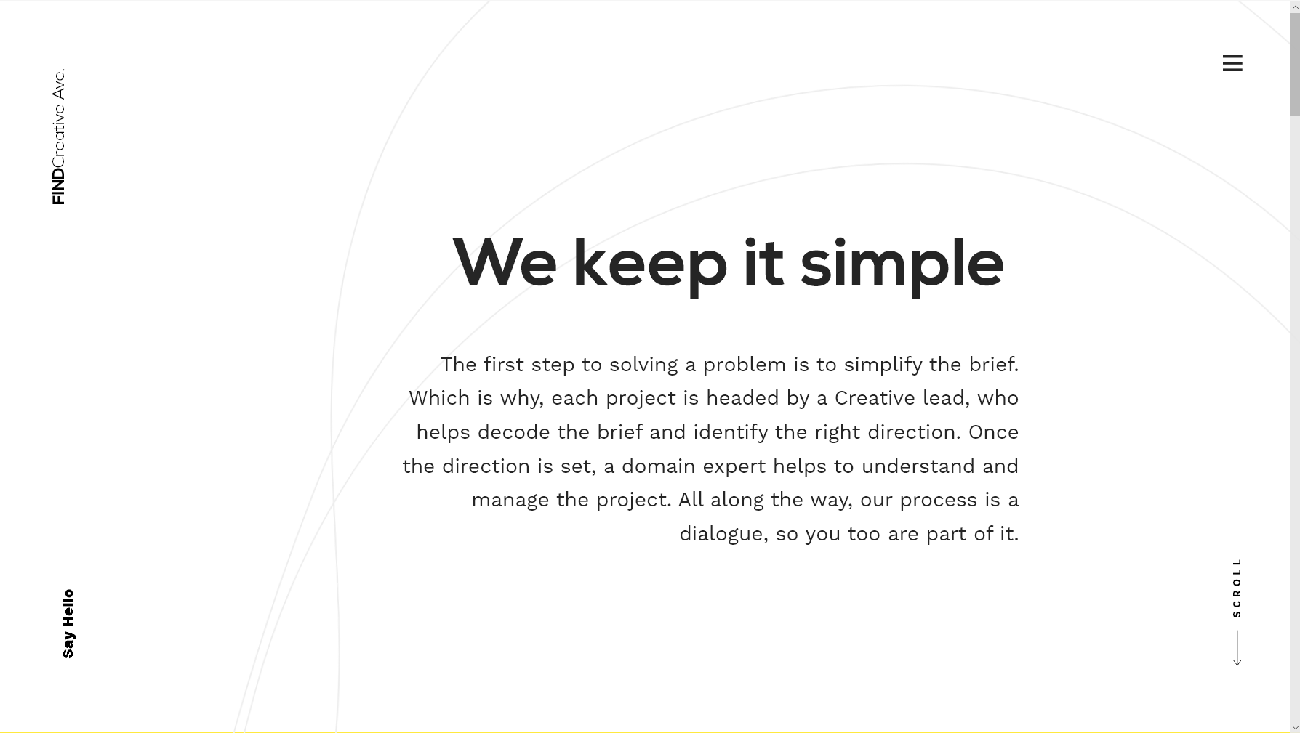
Difference Page- We keep it simple
These lines will keep dynamically moving
Title
Copy
The copy will be provided

Slide 17
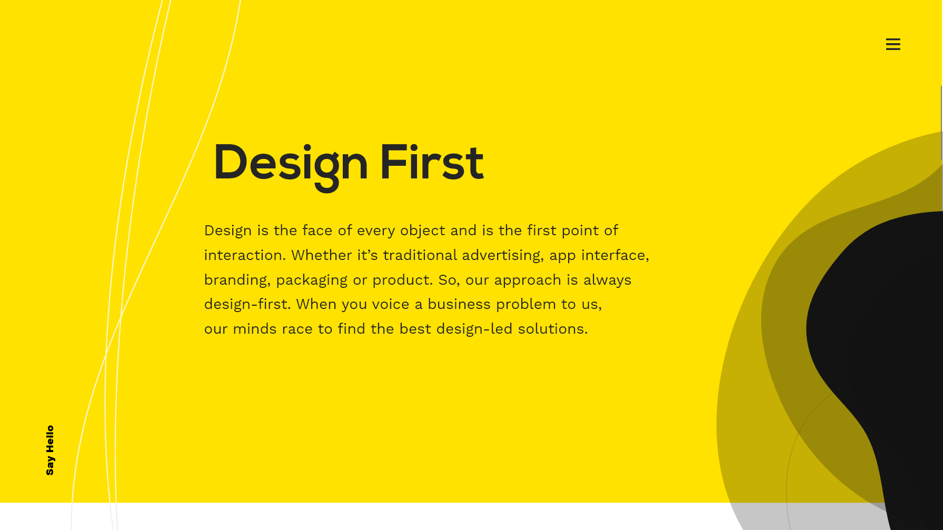
Difference Page- Design First
This amoeba like formation will be constantly moving/changing shape, all the four layers will move separately in different shapes. This will continue to the section below.
These lines will keep dynamically moving
Similar to the previous slide

Slide 18
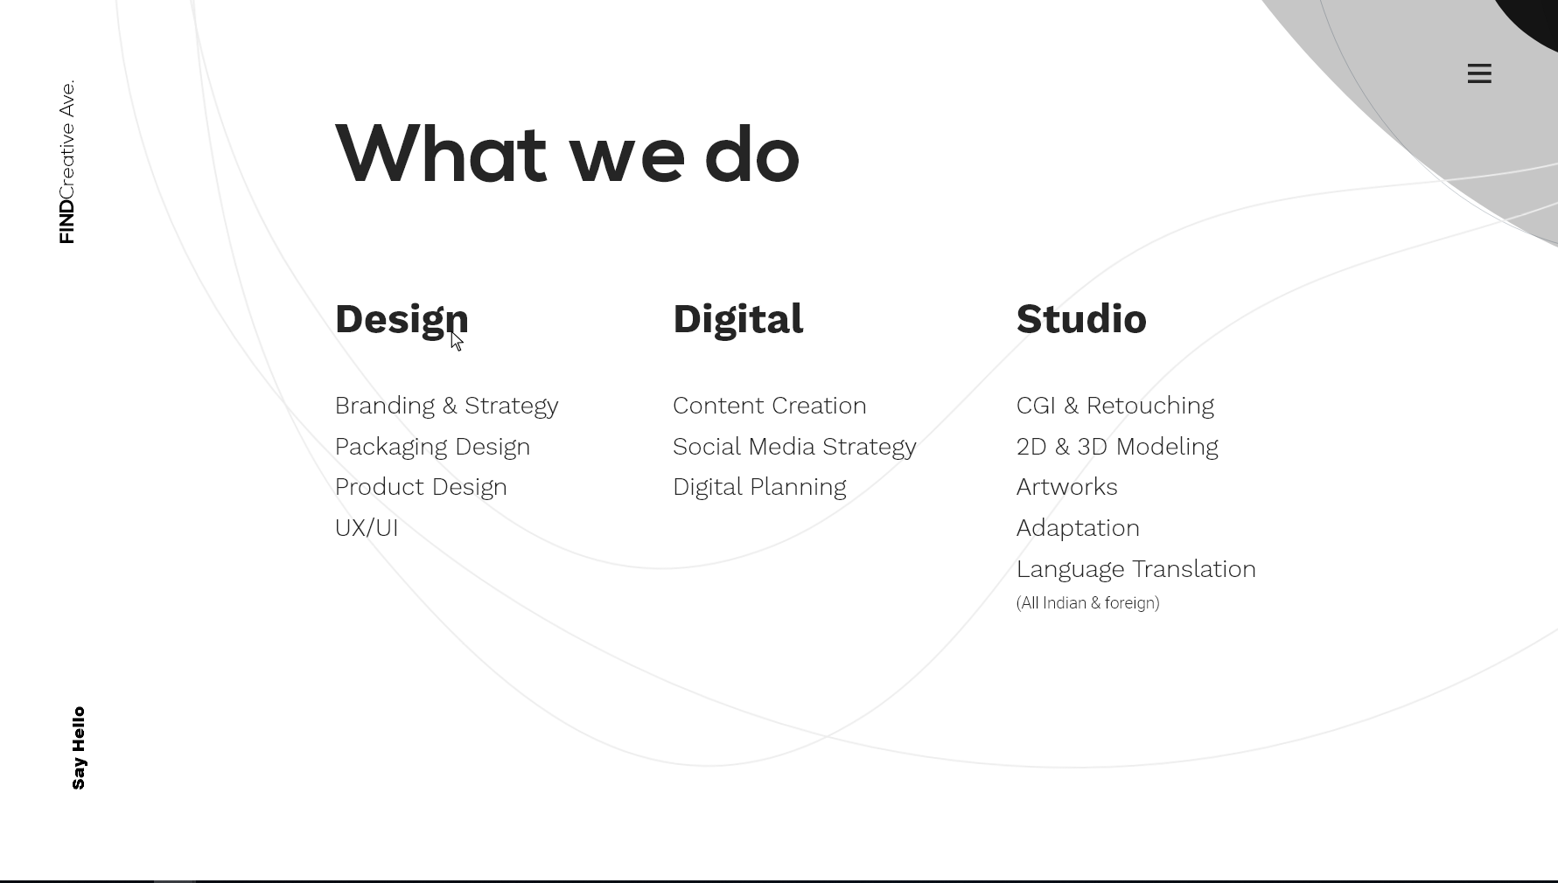
Difference Page- What we do
Continued amoeba formation from the above page
The lines will dynamically keep moving
The copy will stay the same as shown in the slide

Slide 19
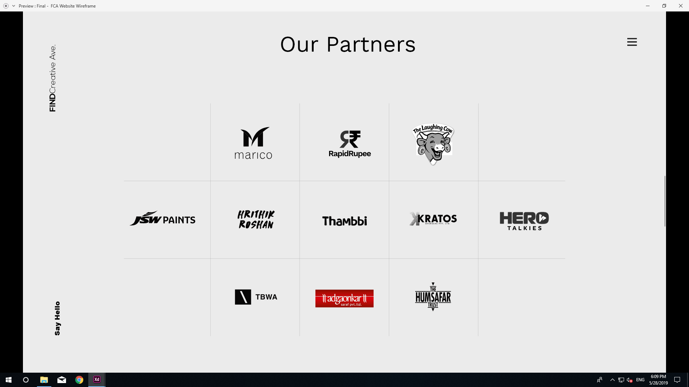
Difference Page- Our Partners
Please follow the xd file shared with you for this page.

Slide 20
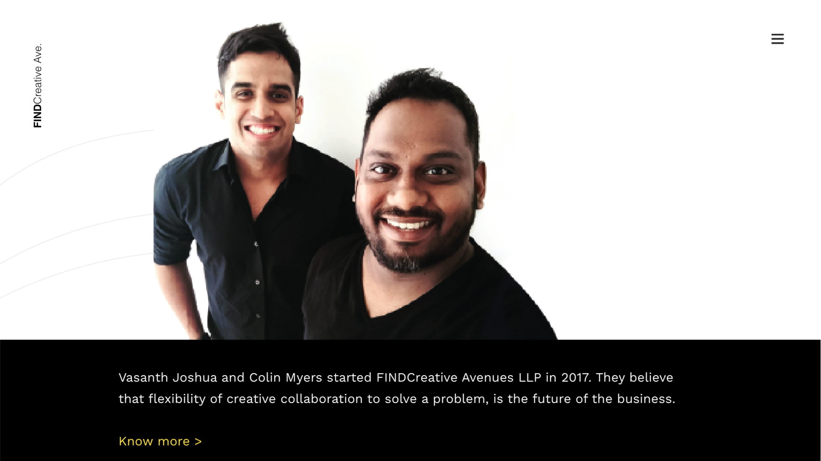
Difference Page- Founders
The image of the founders will be placed here and small description of the brand will follow the image
By clicking Know more> additional info of Joshua & Colin will scroll down (Please refer to the next slide for the copy)

Slide 21
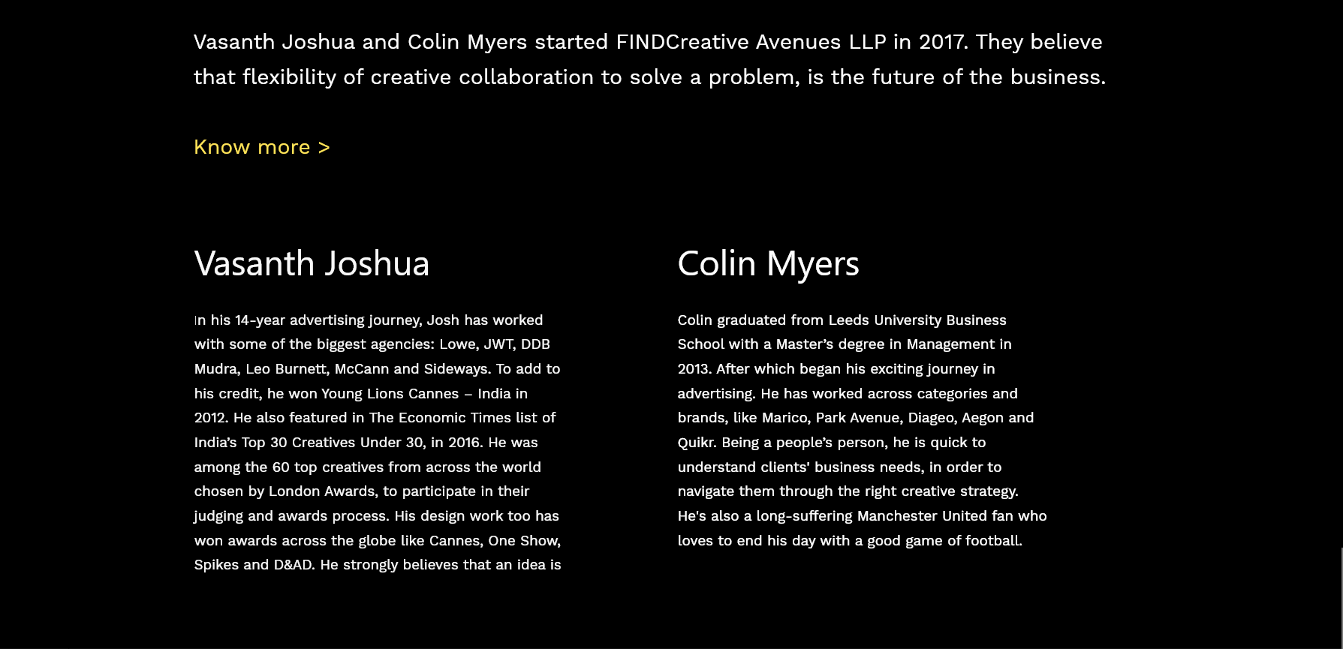
Difference Page- Founders
Please follow the xd file shared with you for this page.

Slide 22
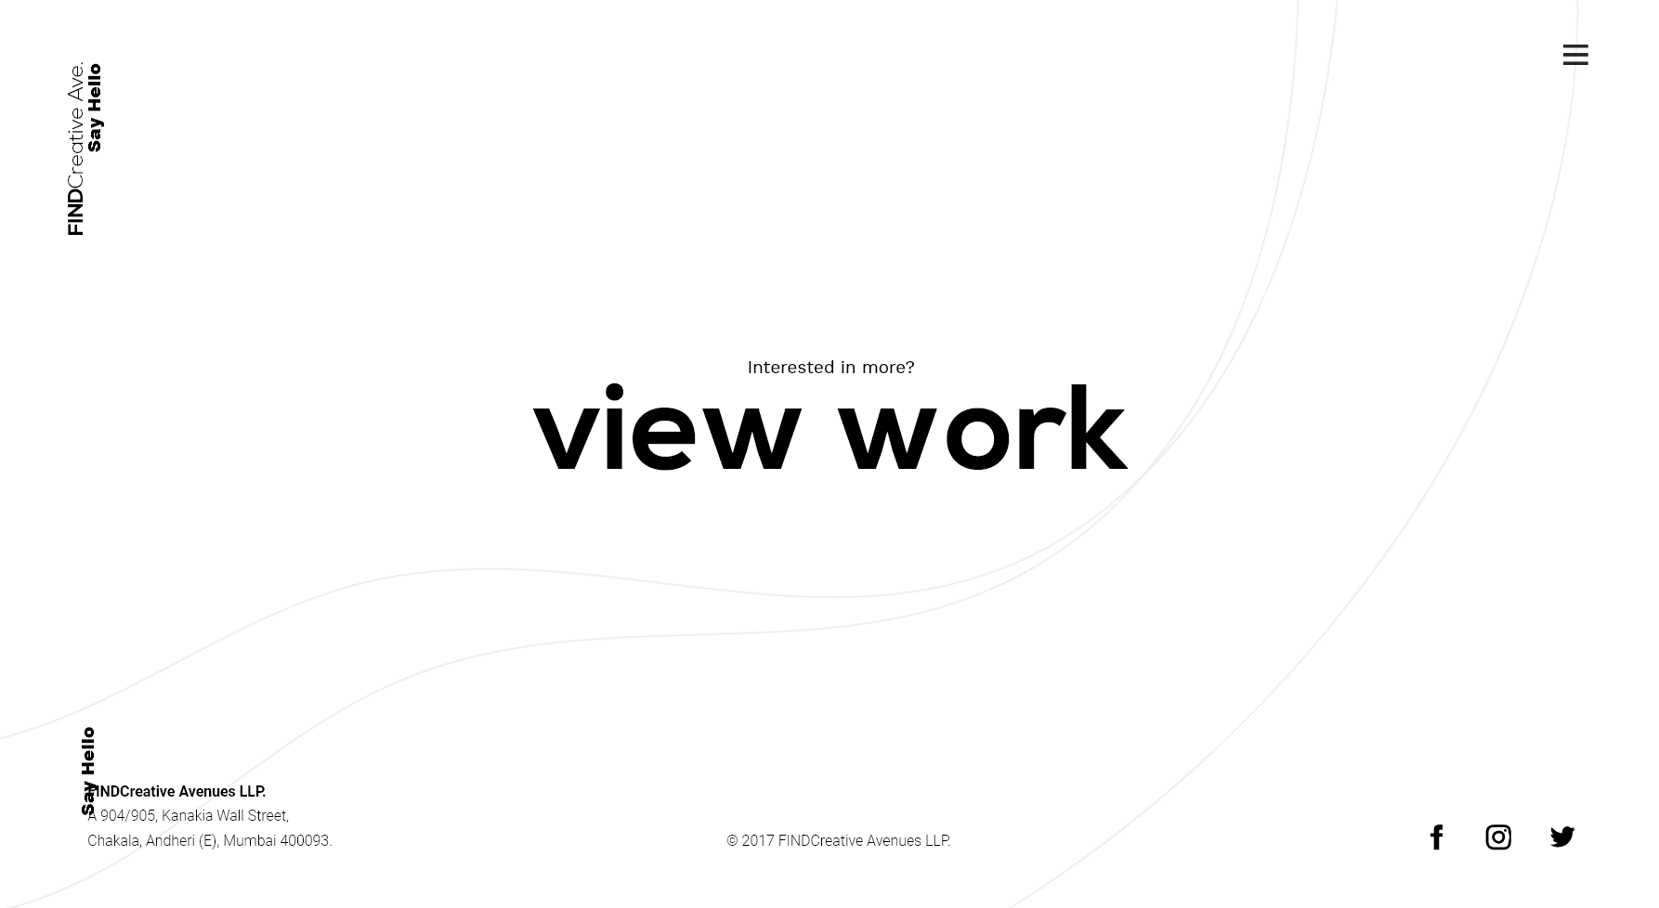
Difference page- Let’s talk
View Work will link to work page
Make the menu button black in color here
Say hello will move up in this page
View work will direct to the Work Page.
There will be no FINDCreative Ave. here
No say hello at the bottom
‘The address & @2017FINDCreative Avenues LLP’ will be present at the end of the last sections in all pages
These icons will direct to their respective social media platforms

Slide 23
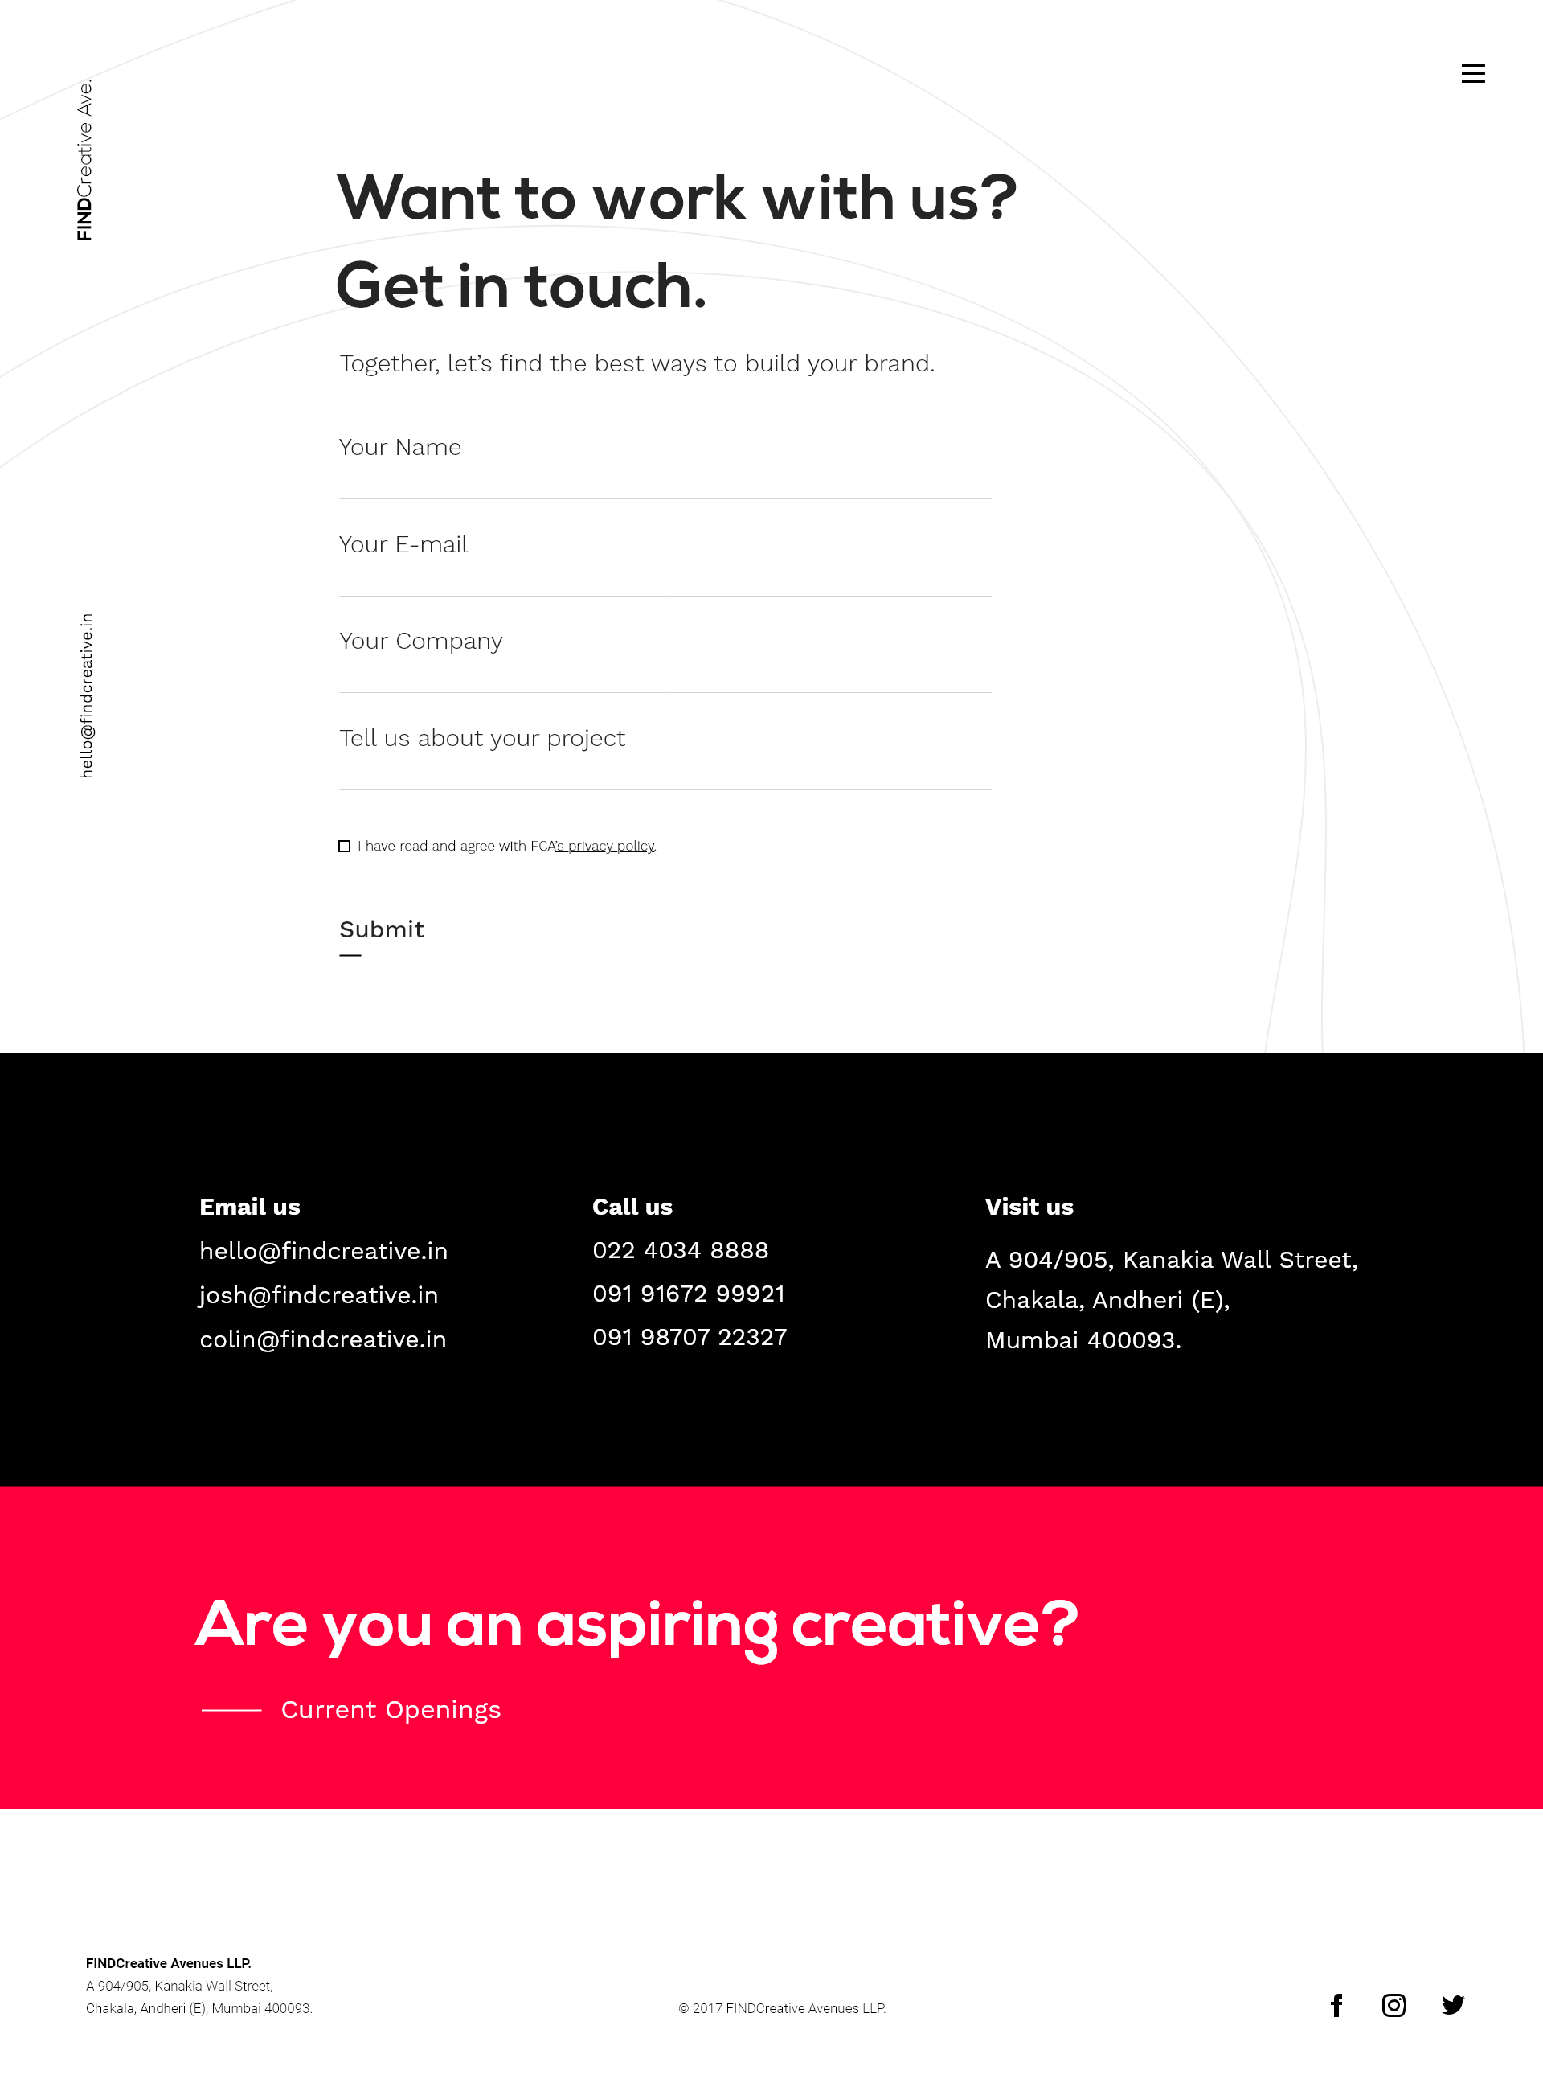
Connect Page
There will be a form which will be mailed to us after the user clicks the submit
The checkbox for Terms & privacy Policy is mandatory.
Terms & privacy policy will be shared with you.
Once clicking submit the information entered by the user should be forwarded to us on our email id.(we will provide you with an email id)
This contact information will be as it is
Current Openings will be clickable text that will lead to Career Opportunities

Slide 24
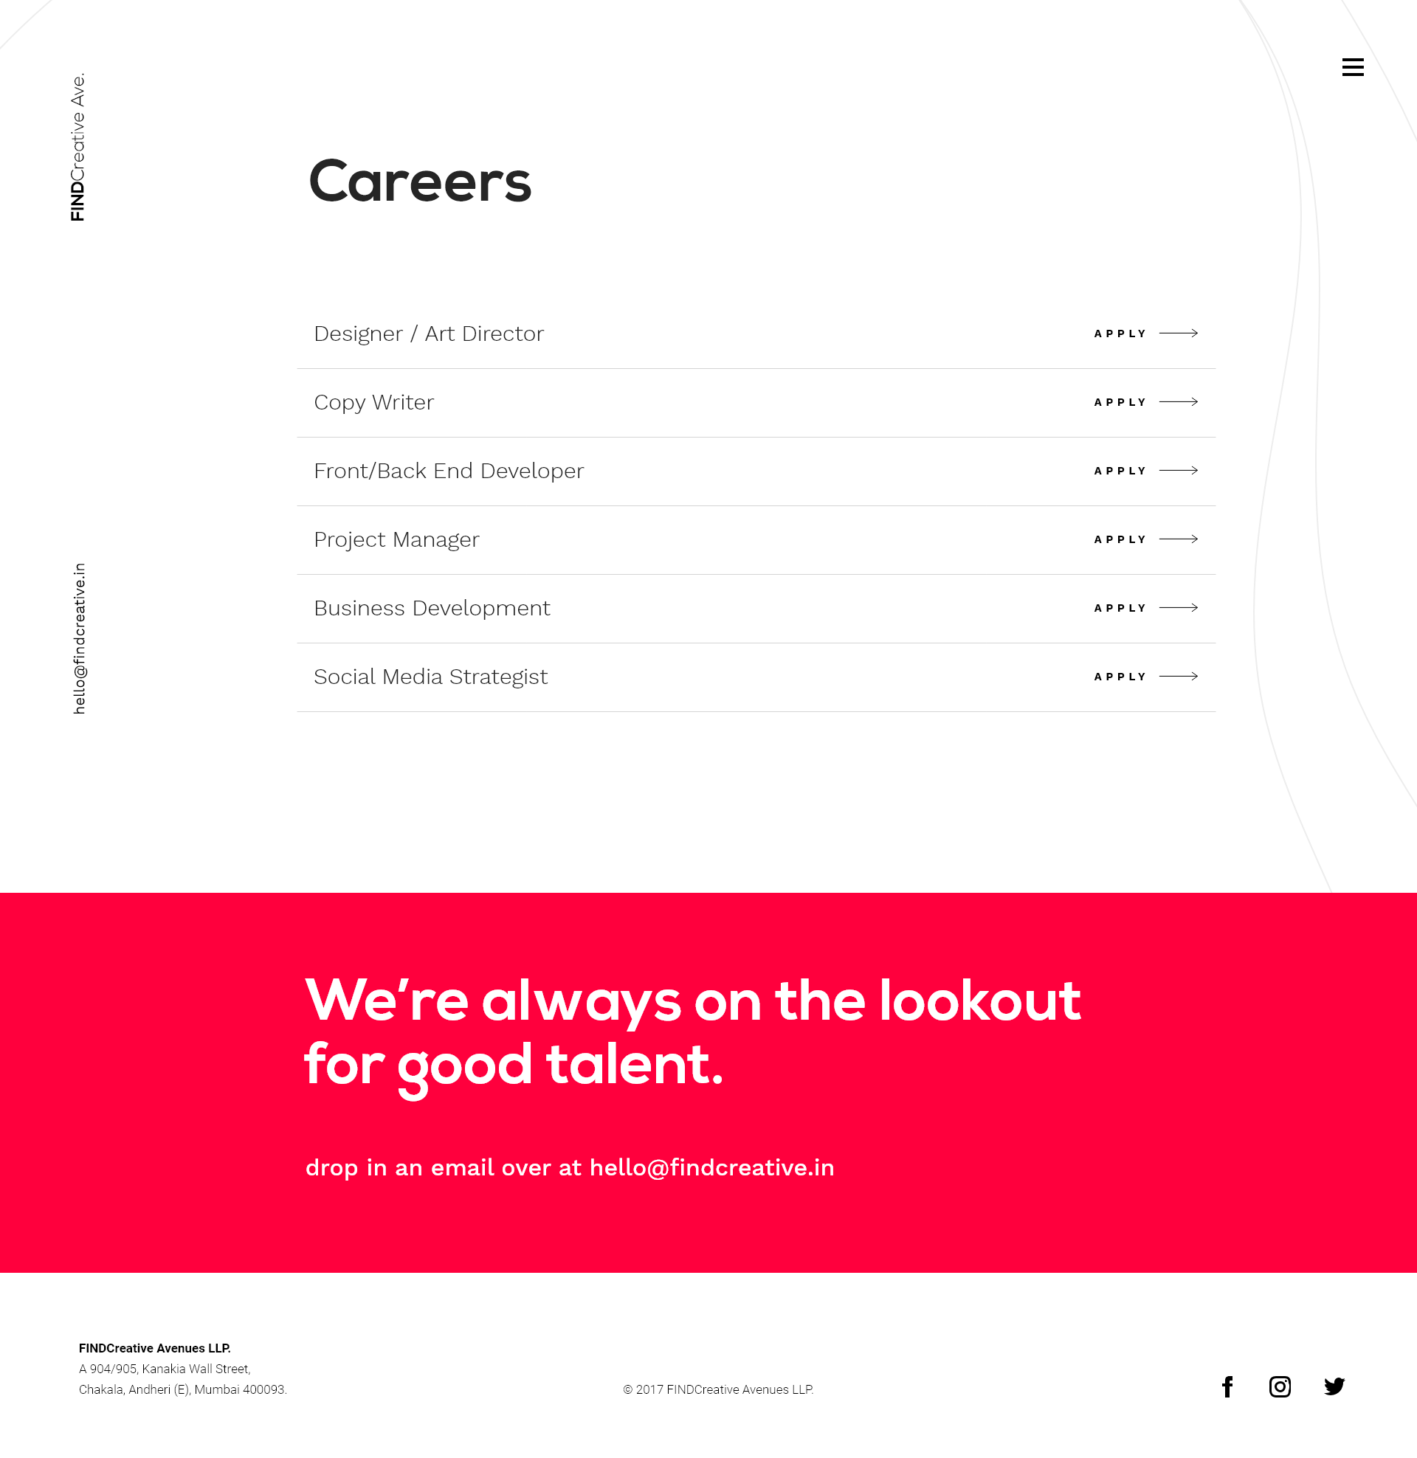
Career Opportunities Page
On this page the APPLY button will link to the Job Description Page of their respective job post

Slide 25
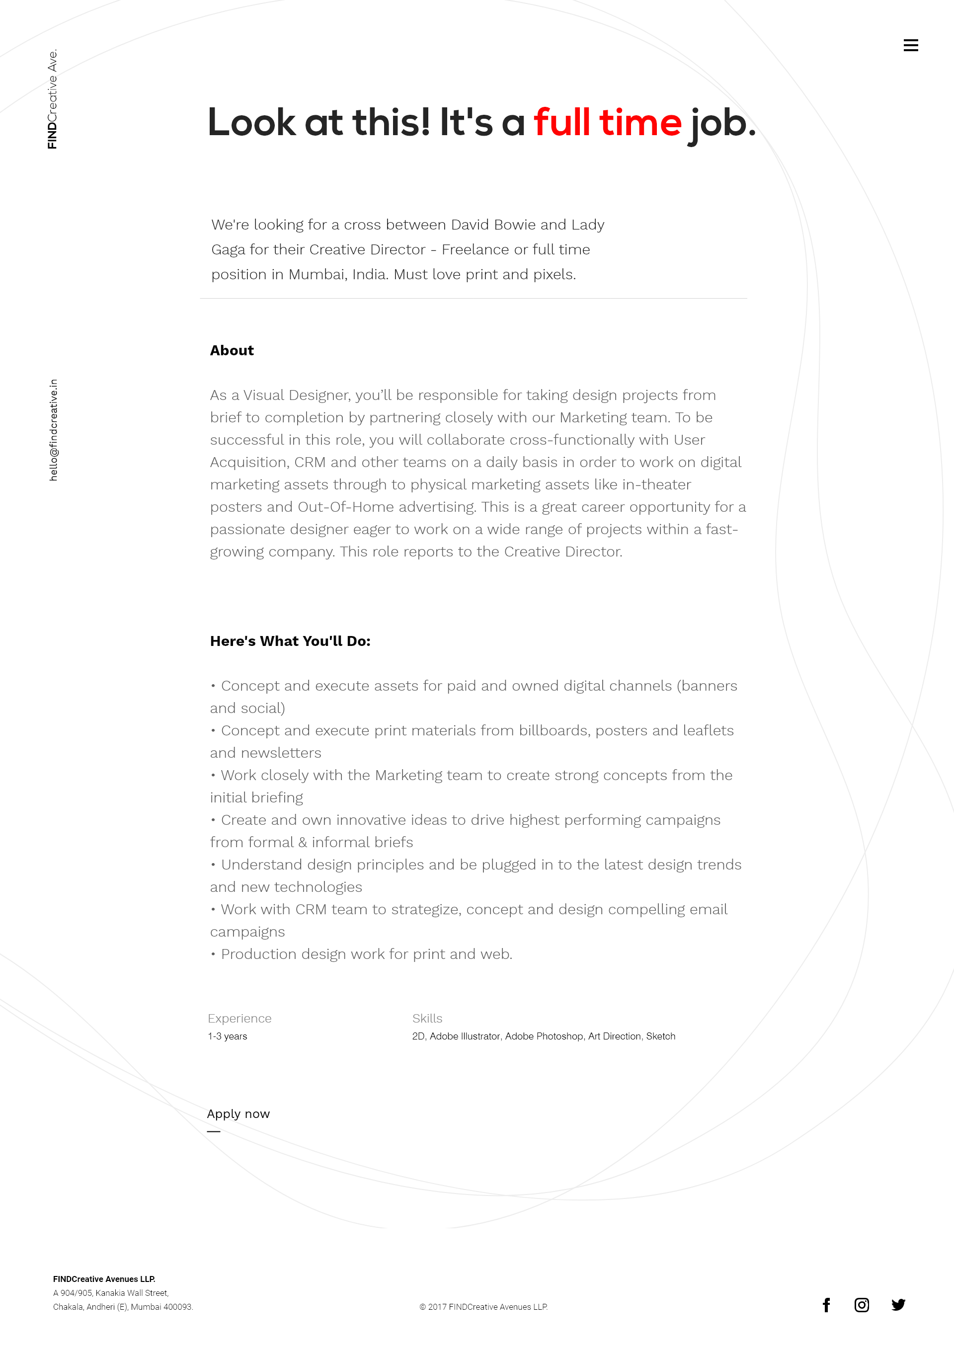
Career Opportunities Page
The copy for this page will be provided and will be different as per the post.
The apply now will link to a form that will allow a candidate to apply for the job post respectively.

Slide 26
Thank you!

